Slide 1





E-COMMERCE
Olist Store Analysis

Slide 2



MEET OUR TEAM
T.A Siva Bhavani
Hymavathi .A
Akash
Tej
swarilipi
Aswathi s nair
Areveti Pranavi

Slide 3





Olist
Store
AGENDA
INTRODUCTION
OVERVIEW
KPI’s
INSIGHTS AND RECOMMENDATIONS
CONCLUSION

Slide 4







OVERVIEW
The Olist Store Analysis project aims to analyze customer purchasing patterns and payment statistics on an E-commerce platform, Olist. This project covers several key performance indicators (KPIs) such as weekday vs weekend sales, payment statistics, delivery time, and customer behavior. The analysis is based on nine CSV files, which are cleaned and manipulated to extract valuable insights.
ORDER NOW

Slide 5
KPI’S
• WEEKDAYS AND WEEKEND PAYMENT STATISTICS
• PAYMENT TYPE WITH REVIEW SCORE 5
• AVERAGE NUMBERS OF DELIVERY DAYS TAKEN FOR PET SHOP
• AVERAGE PRICE AND PAYMENT VALUE OF SAO PAULO CITY
• AVERAGE SHIPPING DAYS VS REVIEW SCORES

Slide 6
KPI’ 1
Weekday Vs Weekend
(order_purchase_timestamp) Payment Statistics
The analysis of payment statistics based on weekday vs. weekend provides an understanding of the buying behavior of customers. This KPI answers questions like, which day of the week has the highest sales? How many customers prefer to pay through online modes? The analysis of this KPI can help Olist to improve their weekend sales and plan promotions accordingly.

Slide 7






KPI’2
Number of Orders with Review score as 5 And payment type as Credit card
This KPI analyses the number of orders with a review score of 5 and payment type as credit card. This helps in understanding customer satisfaction levels and payment preferences. Olist can use this information to identify satisfied customers and encourage them to make repeat purchases

Slide 8
KPI’3
Average numbers of delivery days taken for pet shop
Average number of days taken for
order delivered_customer_date for pet shop
This KPI analyzes the average number of days taken for order delivered_customer_date for pet shop. It helps Olist in identifying areas where they can improve their delivery time and maintain customer satisfaction.

Slide 9
KPI’4
Average price and payment values from customers of sao paulo city
The analysis of average price and payment values from customers of Sao Paulo city helps in
understanding the spending patterns of
customers in this region. It also helps Olist in
identifying high-value customers and creating targeted marketing campaigns

Slide 10
KPI’5
Relationship between shipping days (order_delivered_customer_date - order_purchase_timestamp) Vs review scores
This KPI analyzes the relationship between shipping days and review scores. It helps in understanding the impact of delivery time on customer satisfaction levels. Olist can use this information to optimize their logistics and improve their delivery time.

Slide 11
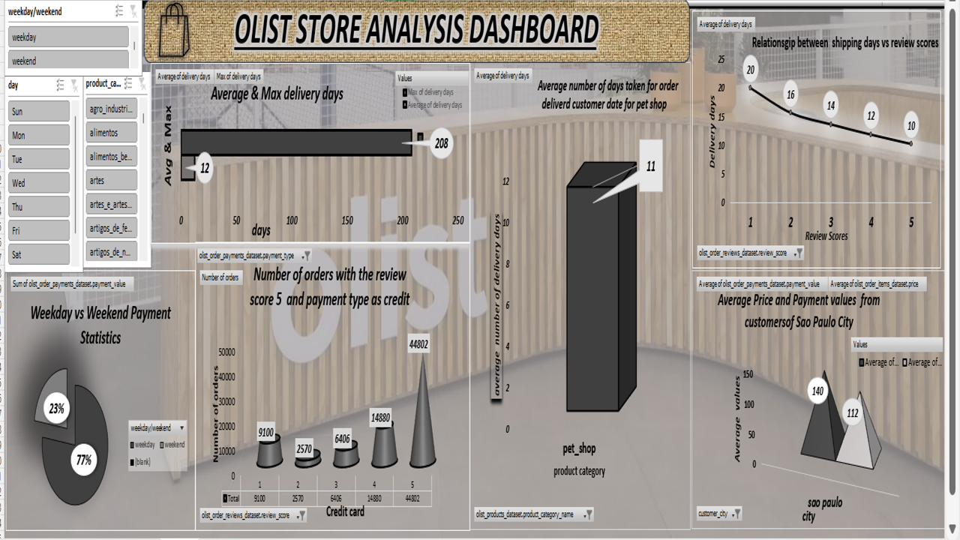
Excel dashboard

Slide 12

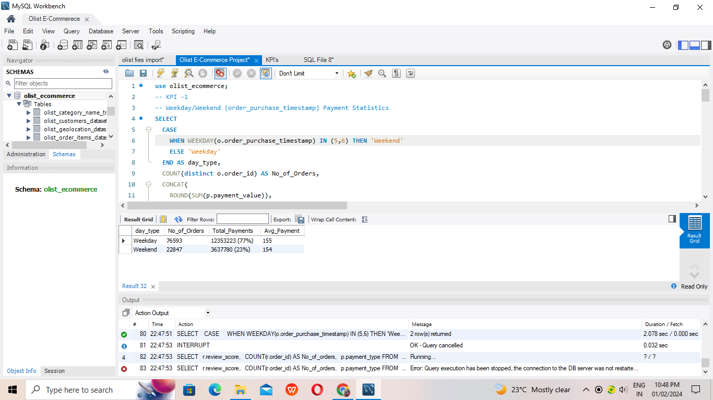
MYSQL KPI1

Slide 13
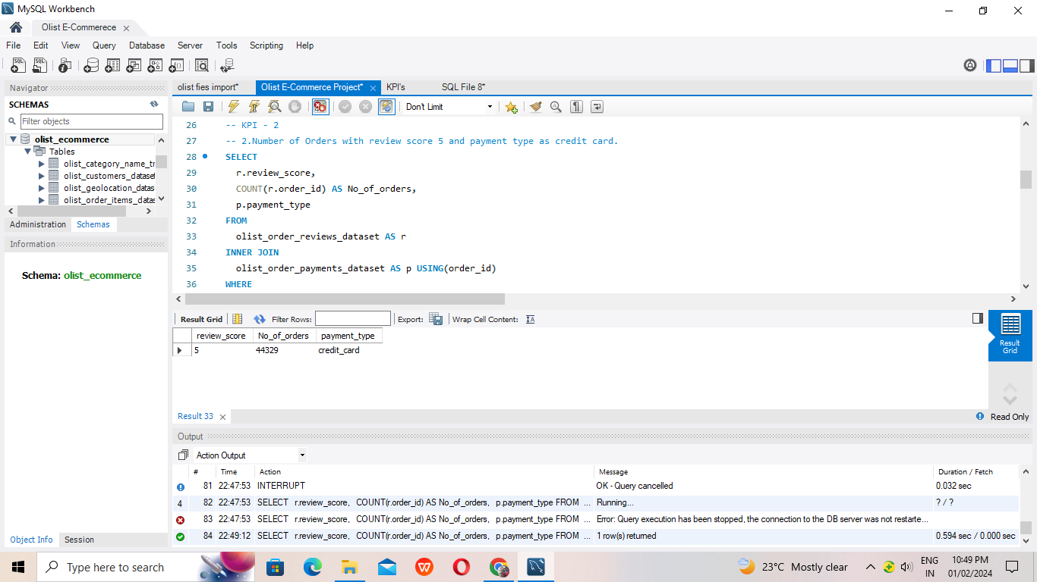
MYSQL KPI2

Slide 14
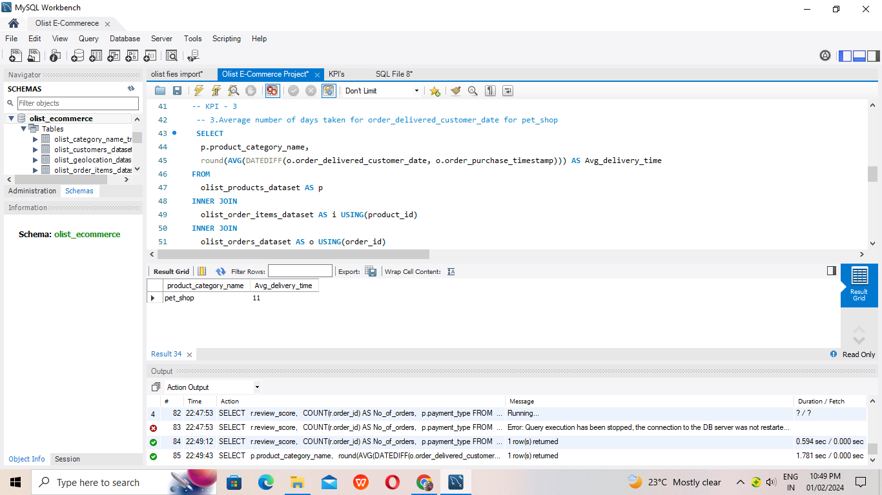
MYSQL KPI3

Slide 15
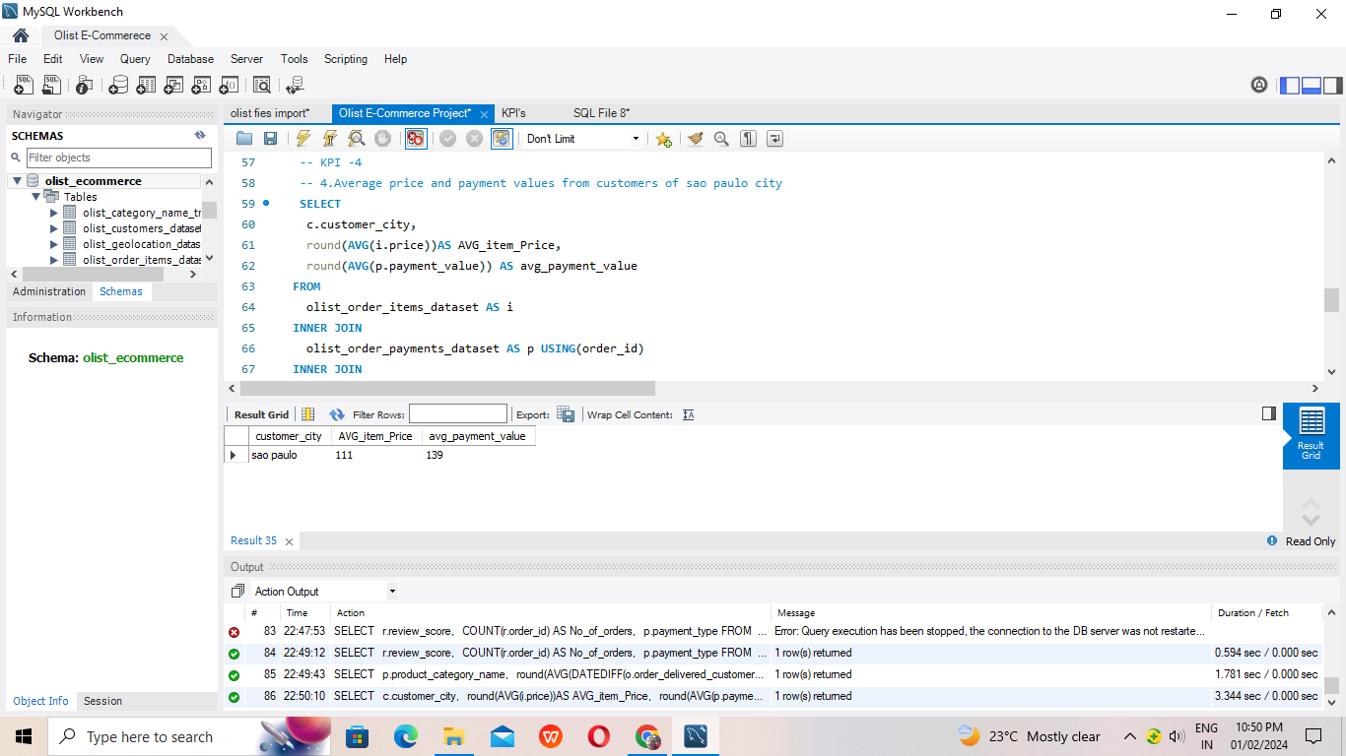
MYSQL KPI4

Slide 16
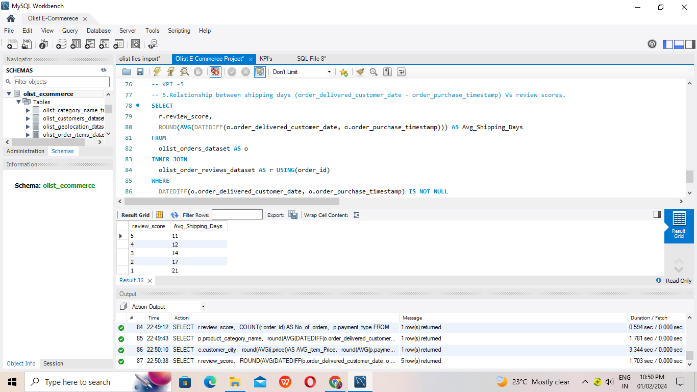
MYSQL KPI5

Slide 17
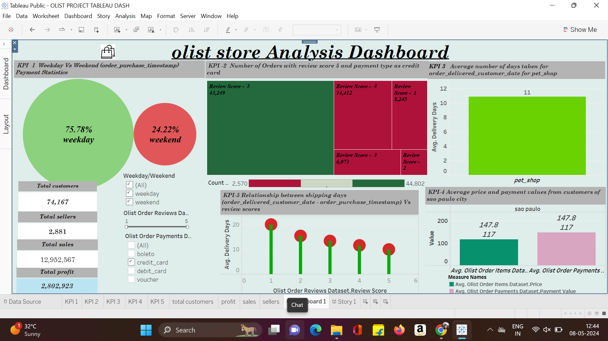
TABLEAU DASHBOARD

Slide 18
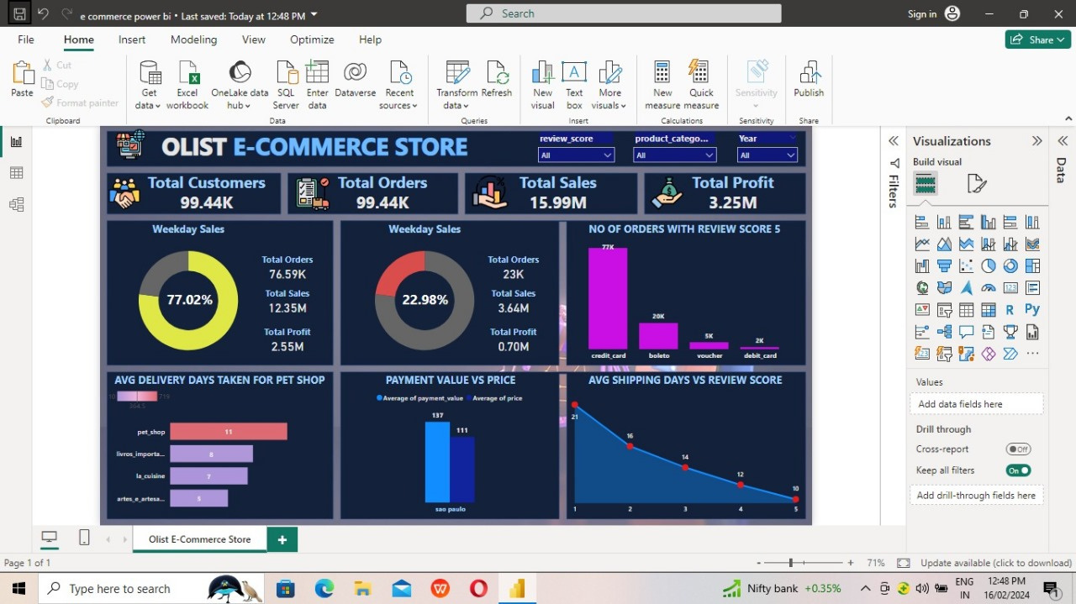
POWER BI DASHBOARD

Slide 19



INSIGHTS
ACCORDING TO THE DATA, OLIST E-COMMERCE HAS ABOUT 99,440 ORDERS. WITH ABOUT 89,940 ORDERS BEING DELIVERED, THE COMPANY HAS A 90% DELIVERY SUCCESS RATE. THEIR AVERAGE PRODUCT RATING IS 4.09 STARS, WITH PRODUCT CATEGORIES GOING AS HIGH AS 4.67 STARS AND AS LOW AS 2.5 STARS. 1 STAR REVIEWS ARE ON THIRD PLACE IN THE REVIEW SCORE DISTRIBUTION RANKING WHICH LIKELY INDICATES THAT THERE COULD BE PROBLEMS WITH PRODUCT QUALITY IN SOME PRODUCT CATEGORIES. DELIVERY PERFORMANCE COULD ALSO INFLUENCE REVIEW SCORES AND SUCCESS RATE COULD CERTAINLY BE IMPROVED.
INSIGHTS FROM THIS ANALYSIS CAN HELP IN MAKING BUSINESS DECISIONS, SUCH AS FOCUSING ON PRODUCTS THAT CUSTOMERS ARE INTERESTED IN, IMPROVING PRODUCT AND SERVICE QUALITY, AND OPTIMIZING MARKETING IN PROVINCES WITH HIGH TOTAL SALES. IN ADDITION, THIS ANALYSIS ALSO PROVIDES AN OVERVIEW OF CUSTOMER CONSUMPTION TRENDS AND PATTERNS THAT CAN BE USED TO DIRECT FURTHER BUSINESS STRATEGIES.
registration

Slide 20

RECOMMENDATIONS
REGULARLY MONITOR AND ANALYZE CUSTOMER REVIEWS TO GAIN INSIGHTS IN PRODUCT QUALITY AND IDENTIFY AREAS FOR IMPROVEMENT. DASHBOARDS CAN BE USED TO IDENTIFY PATTERNS IN CUSTOMER REVIEWS. THIS WILL PROVIDE A DATA-DRIVEN APPROACH TO ENHANCE CUSTOMER EXPERIENCE.
Investigate delivery delays and undelivered orders. Analyzing geographic locations could bring insights about certain challenges with demographics, accessibility, and possible route optimization. Tracking fleet performance with the use of telematics can help identify issues before they become a problem.
Providing a proper shipment tracking system aids in having clear and concise communication between customers, sellers and couriers. Regular updates can set proper expectations among customers and specific delivery instructions of customers can be properly accommodated. By establishing trust and communication, both parties can work together to resolve any issues that may arise.

Slide 21



Summary
Overall, regular monitoring of customer reviews, real-time tracking of fleet performance, together with proper shipment tracking and communication system can improve Olist's delivery and supply chain performance and ensure customers are highly satisfied with the service.

Slide 22
CONCLUSION
The Olist Store Analysis project provides valuable insights into customer behavior and payment statistics. The analysis of these KPIs helps Olist in identifying areas of improvement and creating targeted marketing campaigns. As a data analyst, I have used Excel and Power BI to clean and manipulate the dataset and create meaningful visualizations. This project serves as a great example of how data analysis can help businesses make informed decisions.

Slide 23

Thank You

